Slide 1



STRATEGIC
PARTNERSHIP
Helping you Succeed is our Passion.
Notes:
Warm open. We're Printforce — your sidekick for print. Today I'll show you how our program becomes a hands-off, recurring revenue stream for you and your accounts.

Slide 2

WHO WE ARE
MEET PRINTFORCE
A corporate stationery manufacturer founded in Granny's basement in 1954 — family-owned, employee-rich, and built around one idea: take the print hassle off your desk. We're trade-only, so we sell through you, never around you.
Also known as BCSI (Business Card Service, Inc)
Located in Minnesota.
1954
1983
Trade-only
20yr
Founded — 72+ years of craft
First electronic order — e-commerce pioneer
Since 1992 — no direct sales force
Average employee tenure
Notes:
Establish calm authority. 70+ years, trade-only since 1992, an e-commerce pioneer since 1983. Family-owned, nimble, with the capacity to serve large corporations. We never sell to your customer.

Slide 3
PRODUCTS & CAPABILITIES
MORE THAN BUSINESS CARDS
EVERYDAY STATIONERY
MARKETING COLLATERAL
PROCESSES & FINISHES
Business Cards
Letterhead
Envelopes
Note Pads
Note Cards
Mailing Labels
Greeting & Holiday Cards
Flyers & Sell Sheets
Folded Brochures
Rack Cards
Postcards
Door Hangers
Table Tents
Booklets (Saddle Stitched, Coil, Perfect Bound
Menus
Table Tents
Offset · Digital
Thermography
Foil Stamping & Embossing
Raised UV & Spot Gloss
Raised Foil (digital)
Soft-Touch & Silk Laminate
Die Cutting
Scoring & Folding
Painted Edges
Double-Thick / Pasted Stock
UV Coating
Notes:
Much more than business cards. Everyday stationery, a full marketing-collateral line, and the print processes and finishes to make any of it premium. All of it can run through the same automated program.

Slide 4











WHY SELL OUR PROGRAM
OUR PROGRAM IS AN ANNUITY.
Set it up once and it runs itself. Little to no administrative effort, and you reap the rewards without the involvement. Set it & forget it = freedom.
01 · Set Up
02 · Runs Itself
03 · You Profit
We configure every item, integrate with your storefront, and test until it's flawless.
Orders flow in, print ships, tracking and invoicing return automatically. No buttons to push.
A foot-in-the-door to large accounts you grow by adding items — freight shared, margins compounding.
Notes:
This is the whole pitch. Our program is an annuity — set it up once and it runs itself. You reap recurring rewards without administrative effort. It's a foot-in-the-door to large accounts and highly profitable.

Slide 5
TECHNOLOGY & INTEGRATION
AUTOMATION THAT DOES THE WORK
"The secret to efficient order handling?
Don't handle the order."
INTEGRATION ELIMINATES
PO creation & order entry
— JIM MARCHESSAULT, 1984
Artwork & typesetting
Customer service tickets
95%
of our orders arrive electronically. End users order electronically; we integrate directly with your storefront and the whole chain runs untouched.
Tracking shipments
Manual invoicing & errors
Notes:
The how. Jim Marchessault said it in 1984: the secret to efficient order handling is don't handle the order. 95% of our orders arrive electronically. Integration deletes the seven admin tasks entirely.

Slide 6
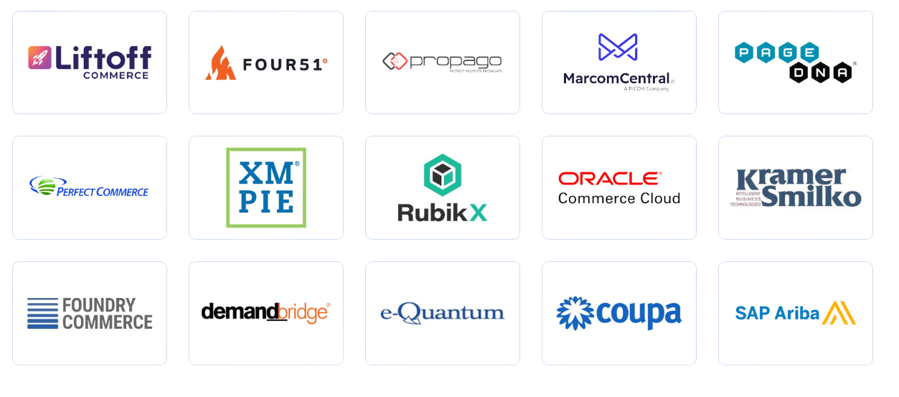
E-COMMERCE SOLUTIONS
INTEGRATION WITH YOUR SOFTWARE
STEP 1
Contact marketing team
STEP 2
Identify SKU’s and load into templates
STEP 3
Test and Go Live
Save Time. Sell More. Mutual Success!
Notes:
Proof. A healthcare account: web portal, print-on-demand, online templates. Orders submitted electronically by end users, integration eliminates distributor admin, tracking and invoicing automated. $250K+ a year in POD print — worry free.

Slide 7
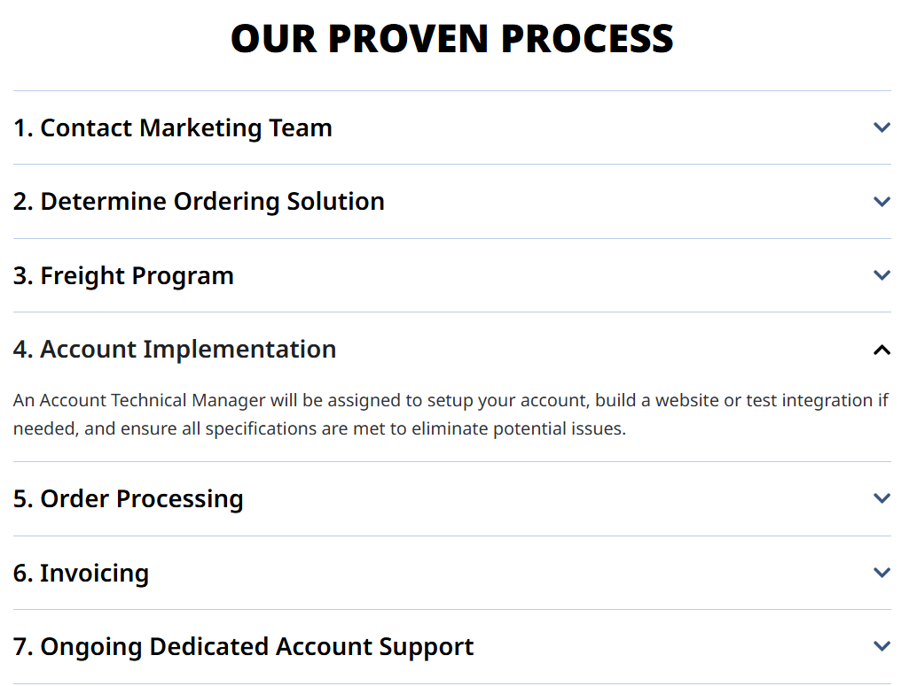

Slide 8
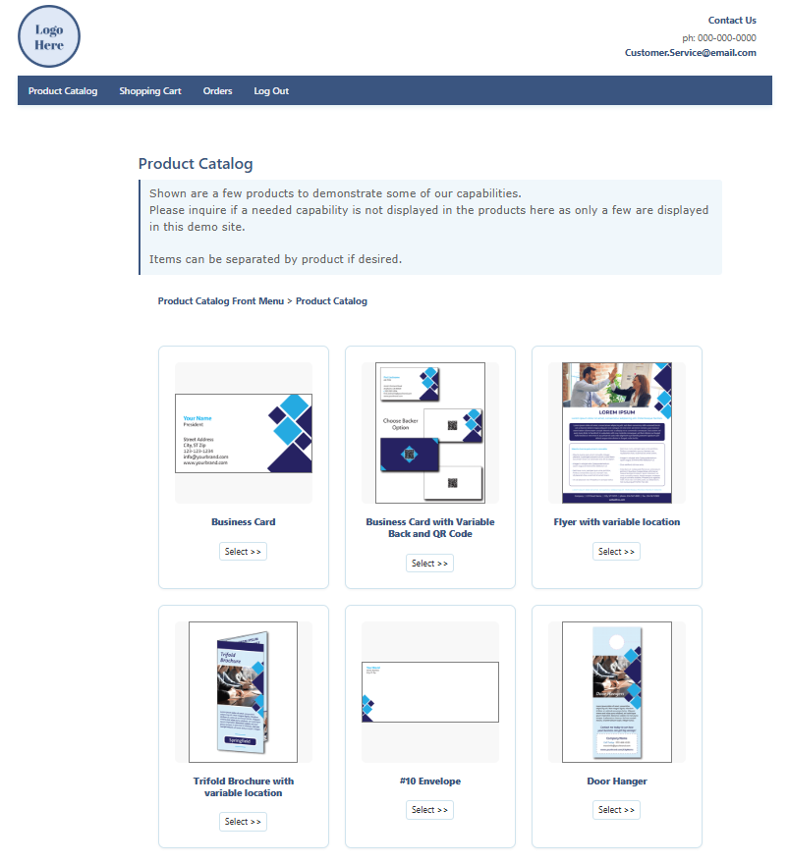
E-COMMERCE SOLUTIONS
CUSTOMER-FACING BRANDED STORES
A web portal for on-demand ordering with online templates. End users submit electronically; our integration eliminates distributor admin, and tracking & invoicing return automatically.
Dynamic templates based on customer art/requirements
Order History/Reorders
Weekly Summary Invoices
Admin login for full visibility
DEMO
Notes:
Proof. A healthcare account: web portal, print-on-demand, online templates. Orders submitted electronically by end users, integration eliminates distributor admin, tracking and invoicing automated. $250K+ a year in POD print — worry free.

Slide 9
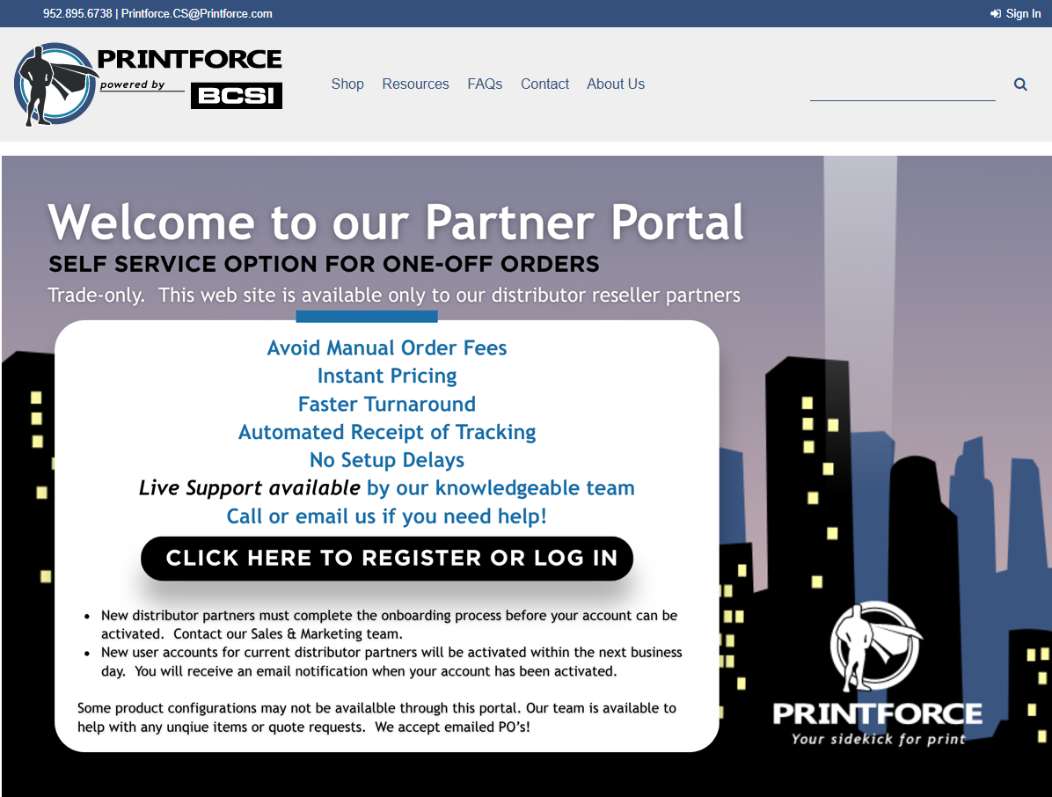
E-COMMERCE SOLUTIONS
PARTNER PORTAL
FOR ONE-OFF ORDERS
Self service solution with PDF upload
DEMO
Notes:
Proof. A healthcare account: web portal, print-on-demand, online templates. Orders submitted electronically by end users, integration eliminates distributor admin, tracking and invoicing automated. $250K+ a year in POD print — worry free.

Slide 10
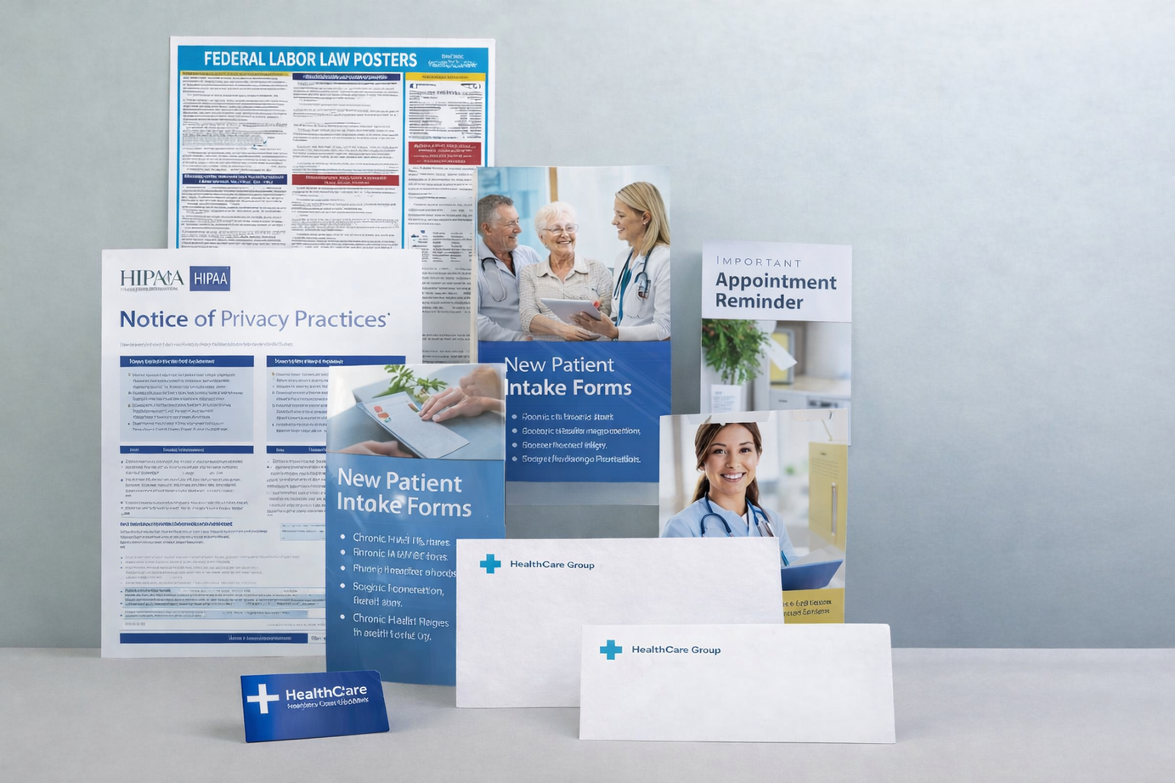
CASE STUDY · HEALTHCARE
AUTOMATED, ACCURATE, WORRY-FREE
A web portal for on-demand ordering with online templates. End users submit electronically; our integration eliminates distributor admin, and tracking & invoicing return automatically.
$250K+
4,500
in POD print, annually
card orders/yr · 2-day turn
Business cards · letterhead · envelopes (all sizes) · sell sheets & flyers · brochures · note pads · rack cards · postcards · note cards
Notes:
Proof. A healthcare account: web portal, print-on-demand, online templates. Orders submitted electronically by end users, integration eliminates distributor admin, tracking and invoicing automated. $250K+ a year in POD print — worry free.

Slide 11
TREND & OPPORTUNITY
THE GROWTH ENGINE: PRINT-ON-DEMAND
Corporations are moving away from warehoused marketing collateral toward on-demand storefronts — no obsolete inventory, always current, always on brand. Grow the account item by item; it all ships together to save freight.
Environmentally friendly
Personalization available
Flyers & Sell Sheets
Folded Brochures
Rack Cards
Postcards
Door Hangers
Table Tents
Envelopes
All automatable →
Notes:
The trend that expands the account. Corporations are abandoning warehoused marketing collateral for print-on-demand storefronts — no waste, always current, always on brand. Every one of these products can be automated.

Slide 12
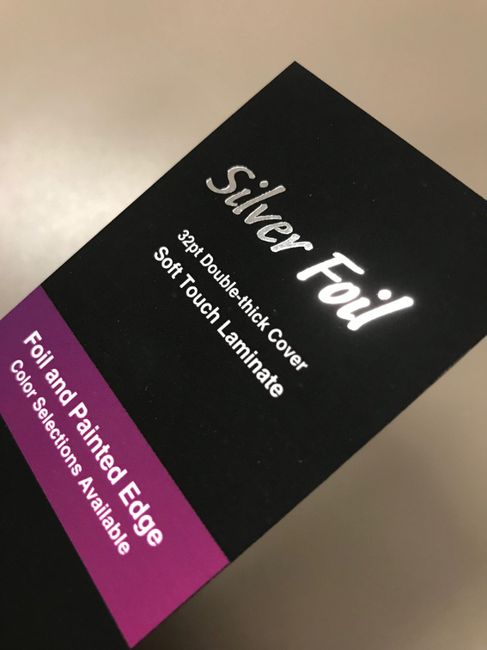
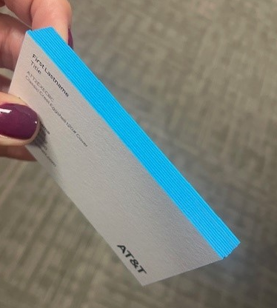
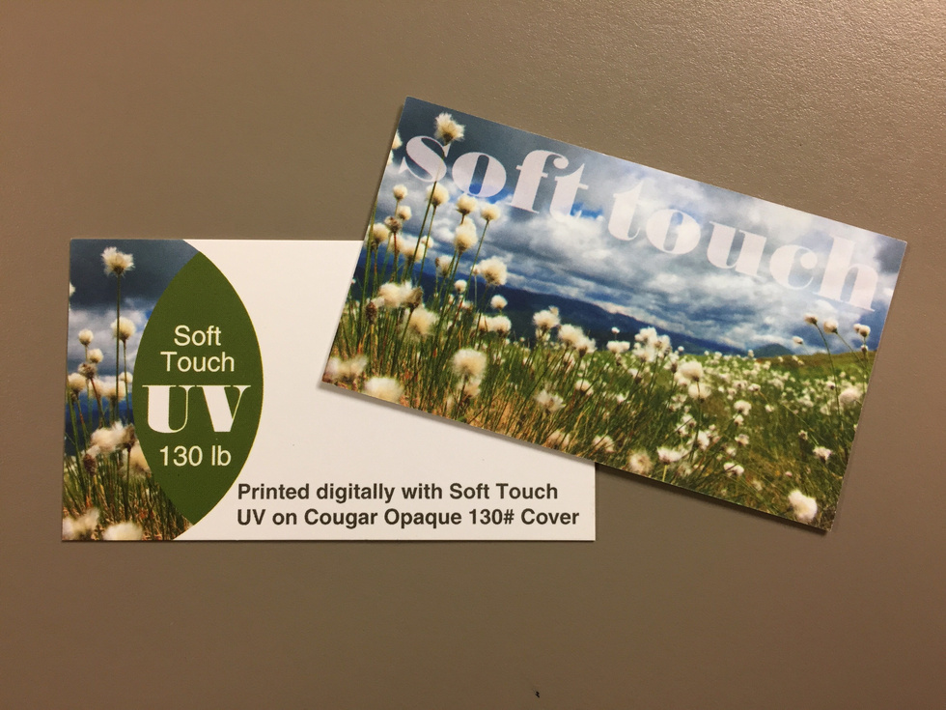
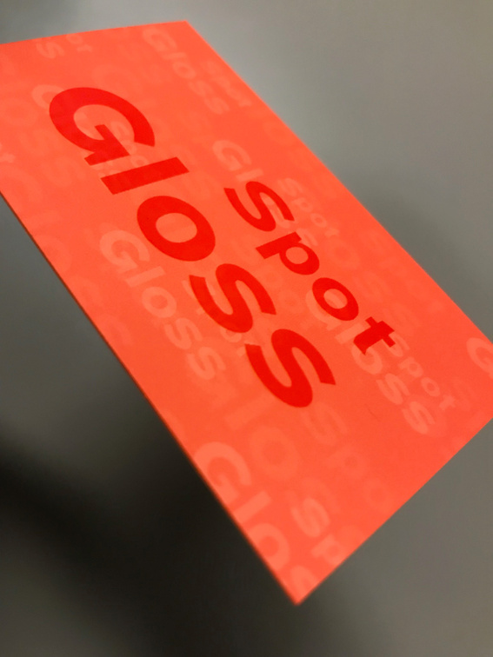
SPECIALTY & SENSORY PRINT
PREMIUM EMBELLISHMENTS THAT STAND OUT
Brand owners want enhanced visual appeal — to capture attention, differentiate from competitors, and elevate corporate image. Because it's digital, samples print at minimal cost.
Soft-Touch Laminate
Raised & Flat Spot Gloss
Raised & Flat Foil
Painted Edges
Double-Thick Stocks
Synthetic · Waterproof · Tear-Resistant
Die Cuts & Shapes
Painted-edge cards
Notes:
The upsell that wins design conversations. Specialty print effects give brands a premium look that captures attention and differentiates. Because they're done digitally, samples cost almost nothing — the customer gets to be part of the design.

Slide 13


HOLIDAY CARDS
BRANDED GREETING CARDS MAKE MEMORABLE BRAND EXPERIENCES
Custom note cards with print embellishments leave a lasting impression
Stock designs can be customized with branding, colors, and messaging available.
Notes:
The upsell that wins design conversations. Specialty print effects give brands a premium look that captures attention and differentiates. Because they're done digitally, samples cost almost nothing — the customer gets to be part of the design.

Slide 14
QUALITY & SPEED
BUILT TO BE TRUSTED
99.8% Accurate
72hr Turnaround
Order accuracy, governed by a 14-point checklist and strict quality controls. Your corporate identity, protected — worry-free.
Average turnaround (2-3 days scheduled). Rushes typically carry no fee — every order and account is treated as high-priority.
Notes:
The safety net. 99.8% accuracy backed by a 14-point checklist and strict QC — corporate identity is protected. Turnaround averages 48 hours, 2-3 days scheduled, and we typically don't charge for rush. Every order is high priority.

Slide 15
COST-SAVING FREIGHT
FREIGHT THAT PROTECTS YOUR MARGIN
ULTRA COST SAVER
FEDEX DISCOUNTED
PLATINUM FLAT RATE · 2-DAY AIR
$8.35 MINIMUM RATE
$12.93
$15.45
USPS & FedEx, single card orders — with zero additional fees.
Average for single card orders to a commercial address. Residential surcharges apply.
Anywhere in the U.S. — including AK & HI — zero additional fees.
Prefer your own carrier? Third-party billing available with a one-time $50 setup.
Notes:
Freight is where small orders quietly bleed margin. We offer options from ultra-low-cost single shipments to a flat 2-day air rate anywhere in the U.S. — including Alaska and Hawaii — with zero added fees.

Slide 16

REBRANDS & TRANSITIONS
STEADY HANDS FOR IDENTITY CHANGE
We help maintain control over business stationery to establish stronger identities and market recognition — with real expertise across mergers, acquisitions, logo changes, and corporate identity shifts.
✓
Import a spreadsheet of imprint details — we create the orders and proofs
✓
We work with you to find the best print process for the need
✓
Consistency held across every location and reorder
Notes:
A high-value moment to own. Mergers, acquisitions, logo and identity changes — we help maintain control over stationery so brand recognition stays strong. Hand us a spreadsheet of imprint details and we'll build the orders.

Slide 17
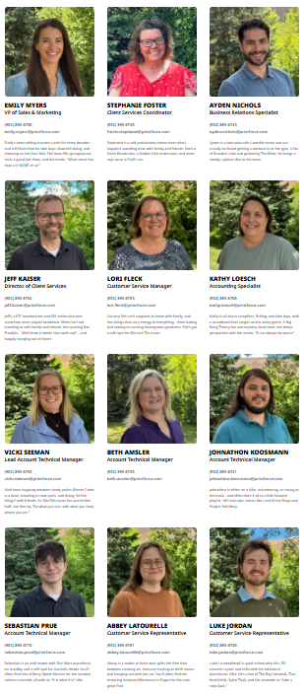
WE ARE YOUR HELPERS
THE HUMANS BEHIND EVERY ORDER
Highly automated and deeply human. When you need us, real people who know your account pick up.
Account Technical Manager
Customer Service
Coordinates setup and new-item testing; ensures manufacturing follows customer specifications.
Supports order questions — status checks, ship-method changes, and everything in between.
Order Processing
SUPPORT TEAM LEADERSHIP
Jeff Kaiser Director of Client Services
Lori Fleck Distributor Manager
Emailed orders handled at print.orders@printforce.com — PO plus artwork, and we take it from there.
Notes:
Highly automated and deeply human. Behind every automated order is a small, senior team: an Account Technical Manager for setup and testing, customer service for order questions, and a dedicated order-processing inbox.

Slide 18
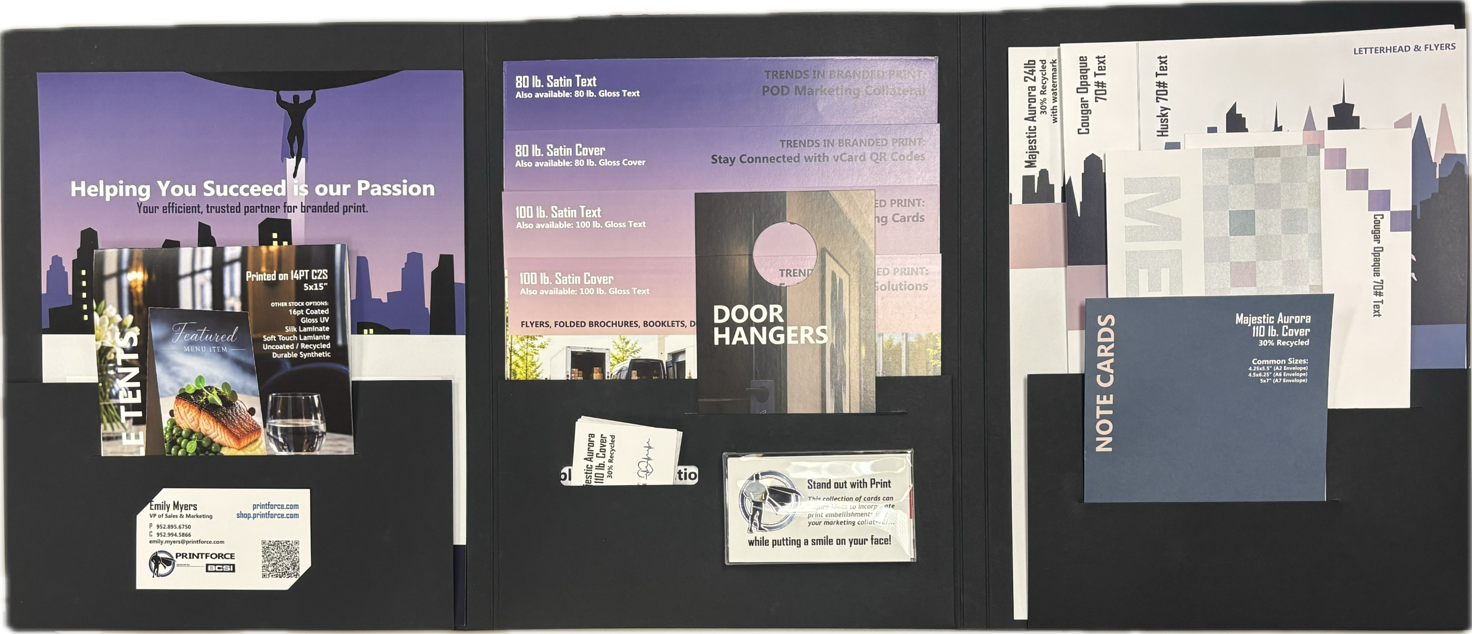
SALES TOOLS
SAMPLE KITS THAT SELL
Unbranded sample packets showcase the products and paper options we most commonly offer — now updated with vertical-market examples and sell sheets.
✓
Help clients visualize quality and make confident paper choices
✓
Inspire creativity with specialty embellishments and finishes
✓
Demonstrate the full range of possibilities across industries
Hand one to a prospect and watch the conversation shift from "maybe" to "let's do this."
Also in your kit: pitch deck & sell sheets · joint sales calls · on-site tours
Notes:
Our sharpest tool. Unbranded sample kits showcase our most common products and paper options — now with vertical-market examples. They let a client feel the quality, spark specialty ideas, and see the full range across industries. Hand one over and the conversation shifts from maybe to let's do this.

Slide 19
PARTNERSHIP
WE INVEST IN YOU.
Save time. Sell more.
"The Printforce team has been absolutely fantastic to work with… they really treat the relationship as a partnership. I'm choosing Printforce every day of the week!"
Integrating to automate the process and reduce your costs.
Partnering to sell new accounts with options, samples, and advice.
— JEREMY LACEY, DISTRIBUTOR PARTNER
Helping through implementation so expectations are met.
Earning your business every day, and continually investing in new technology.
Notes:
The partnership close. We can only grow if you're selling, so we invest in you: integrating, partnering on new accounts, helping through implementation, earning your business daily, and learning your goals. Then land the testimonial.

Slide 20
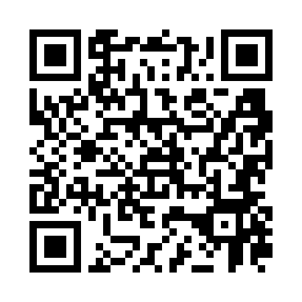
LET'S WORK TOGETHER
START WITH ONE CUSTOMER
Move one account to automated print and see the time savings firsthand. Need samples? We'll get a pack in your hands. And we're always glad to meet on a good-fit opportunity.
EMILY MYERS
STEPHANIE FOSTER
AYDEN NICHOLS
Scan to request a sample packet — holiday cards included.
shop.printforce.com
VP of Sales & Marketing
Client Services Coordinator
Business Relations Specialist
(952) 895-6750
emily.myers@printforce.com
(952) 895-6745
foster.stephanie@printforce.com
(952) 895-6743
ayden.nichols@printforce.com
Notes:
The ask. Let's move one customer over to automated print and see the savings firsthand. I'll get you a sample pack if you don't have one, and I'm always glad to meet on a good-fit opportunity. Here's how to reach us.

